Slide 1



Trading Vision Project (TVP)
PRESENTED BY
20107793 - Han Ngo Gia
20107788 - Nguyen Nguyen Bao
20107785 - Minh Quach Hoang
20108272 - Thu Nguyen Vu Anh
SUPERVISOR
Ms. Le Thi Nhan

Slide 2
Table of Contents
1
2
1
Context
Objectives
3
4
5
Project Management
Project Deliverables
Evaluation

Slide 3

Context

Slide 4
Context
3
The customers have a budget, and they want to invest in the Vietnamese stock market. They would like to have a web application to update stock trends.
The customers would like the application to have overview page, chart page, reminder, favorite list page and user information page.
🔶 The main requirement is the website should also give the auto trend prediction in the next 5 days.

Slide 5

4
Objectives

Slide 6

Objectives
5
Our website objectives include creating:
Home page shows stock prices and stock exchanges
Specific page shows stock detailed information and charts
Reminder page stores all the reminders
Favorite page with favorite stock list
Profile page with user’s information and delete account permanently

Slide 7
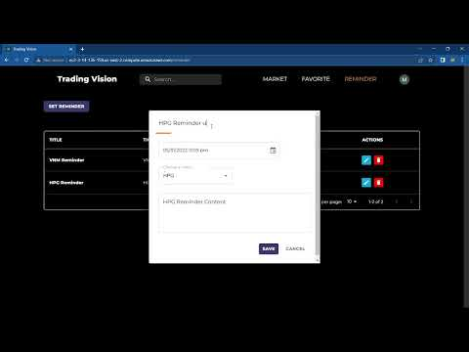
Demo
6
Video Demo

Slide 8

7
Project Management

Slide 9
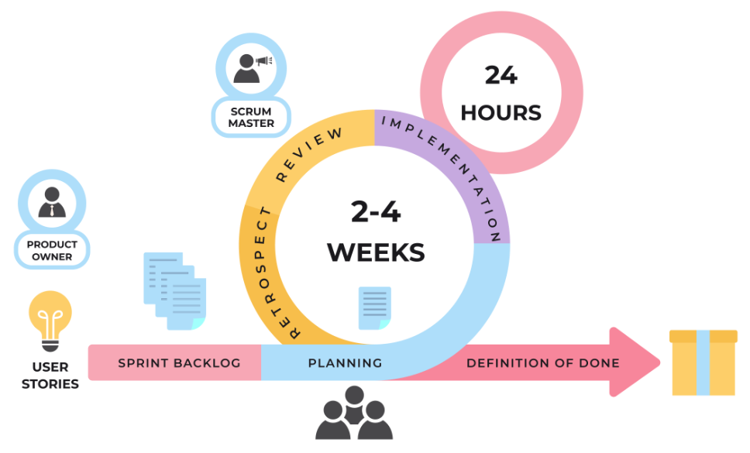

Project Management
8

Slide 10
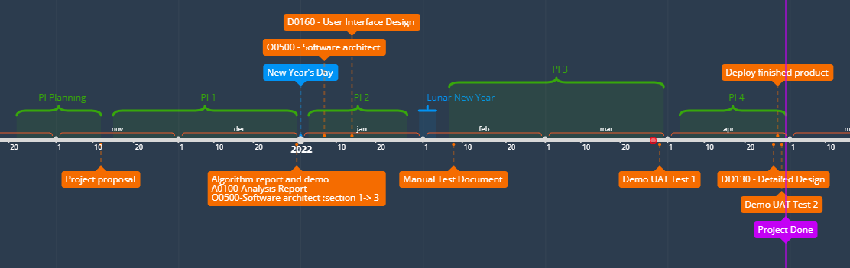
Milestones
9

Slide 11
10
Project Deliverables

Slide 12

Project Deliverables
11
Documents
A0100 - Analysis Report
A0100 - Analysis Report_ Benchmark Server
O0500 - Software Architecture
DD130 - Detailed Design
D0160 - User Interface Design

Slide 13

Project Deliverables
12
Data
Set up all necessary collections in MongoDB
Stock company information
Query for prediction
Stock prices
Predicted Prices
Reminders
Favorites
Users

Slide 14
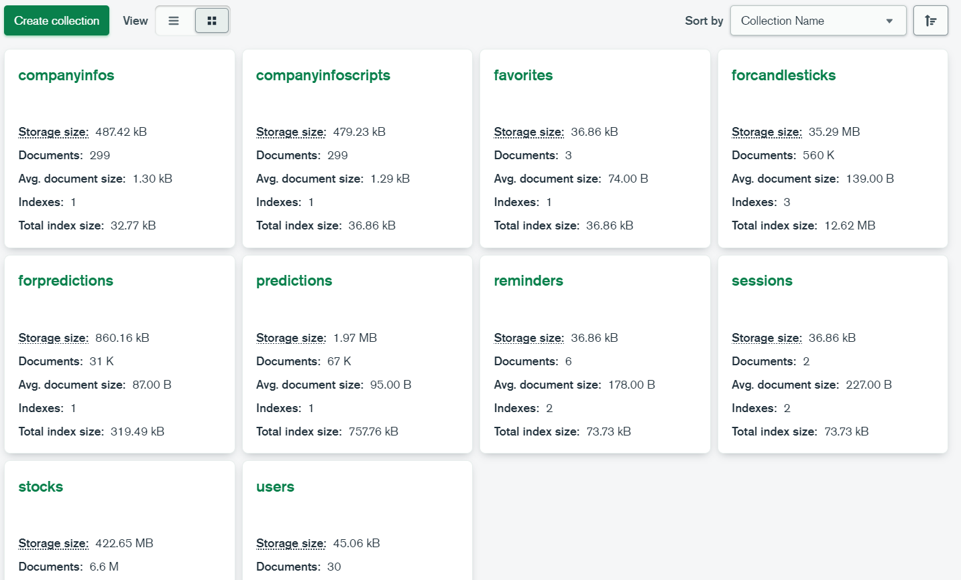
Project Deliverables
13

Slide 15

Project Deliverables
14
Website
All the website’s UI
Set up all necessary APIs for the website
Deploy successfully

Slide 16


Project Deliverables
15
Algorithm
Successfully implemented selected algorithm and export model.
After doing research, we have found some algorithms; however, we selected three algorithms suggested to solve our problem:
Long short-term memory (LSTM)
Support Vector Machine (SVM)
Polynomial Regression

Slide 17

Project Deliverables
16
Algorithm
After evaluating LSTM, Polynomial Regression and SVM, it is evident that LSTM gives the best performance among the three algorithms .
The LSTM algorithm will be chosen for predicting stock trend in the project.

Slide 18




LSTM Process
17
Data
Training
Model
Prediction

Slide 19


LSTM Challenges
18
Parameters
Collect “garbage”

Slide 20
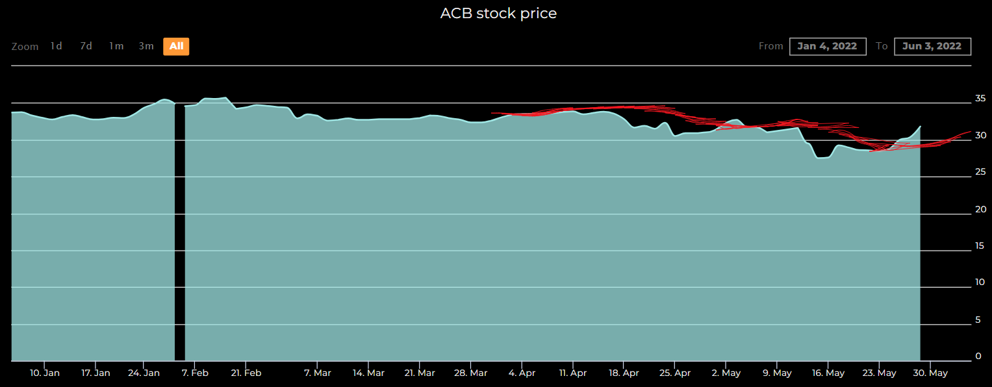
Project Deliverables
18
ACB Stock Prices

Slide 21
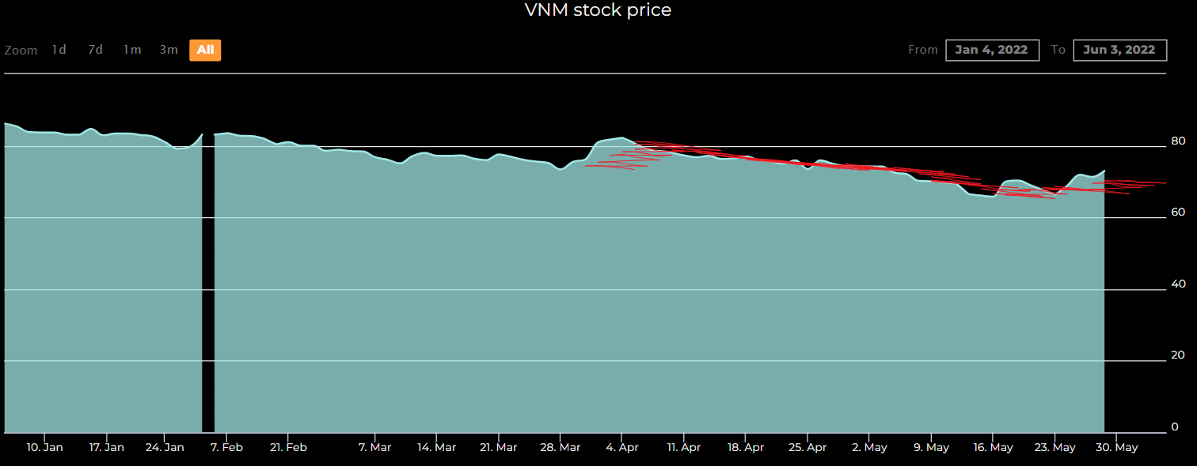
Project Deliverables
19
VNM Stock Prices

Slide 22

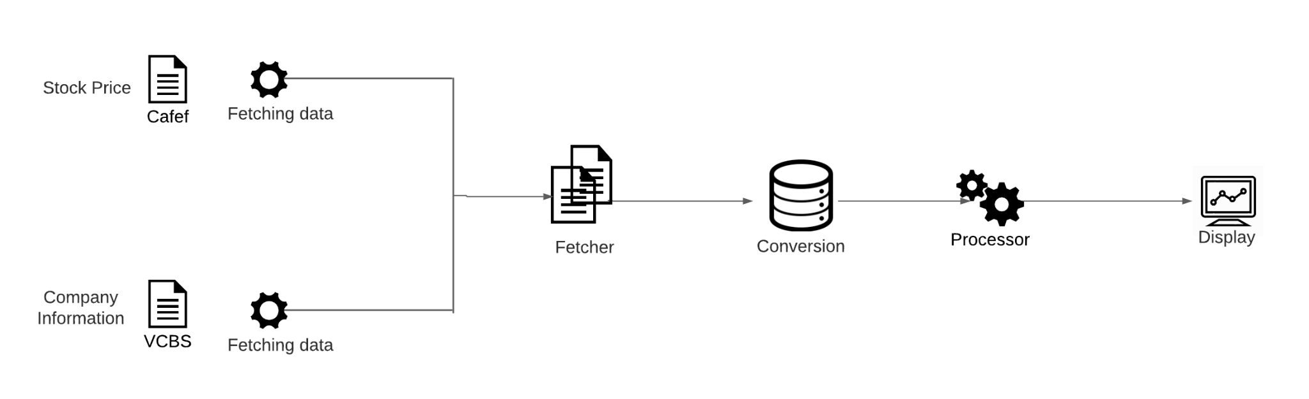
Project Deliverables
20
Fetch Data

Slide 23
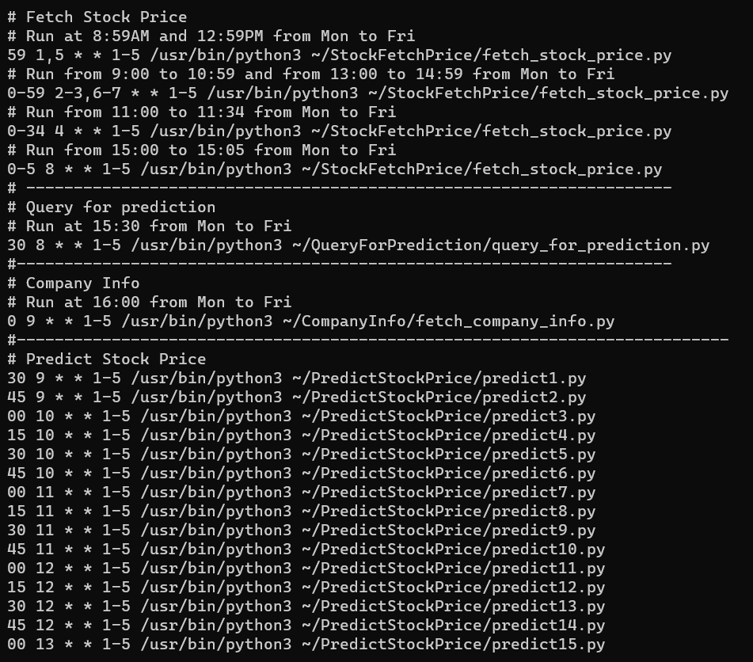
Project Deliverables
21
Cronjobs
Cronjob’s Configurations

Slide 24

Project Deliverables
22
Test
Smoke test
UAT - User Acceptance Testing

Slide 25

23
Evaluation
Challenges
Evaluation Team
Team Contribution

Slide 26

Evaluation
24
Challenges
We have some challenges in the task
We have to continuously optimize code after finishing them
We didn’t have any experience with NodeJS, Express, MongoDB, ReactJS, Material UI, Amazon EC2 server, Nginx before

Slide 27

Evaluation
25
Team
Members did their assigned tasks on time, and drew from those a lot of experience.
Members updated progress everyday for team leader. Therefore, every issue is solved quickly.
Maintain weekly meeting at office with client for every Thursday to get feedback. Hence, team can modify plan appropriately.

Slide 28
Evaluation
26
Team Contribution
26.50%
26.25%
Minh Quach
Nguyen Nguyen
Backend Developer, Algorithm Researcher
20.75%
Team Leader,
Frontend Developer, Server Administration,
Tester
26.50%
Thu Nguyen
Han Ngo
Algorithm researcher, Developer Support,
Document Writer
Frontend Developer, Algorithm Researcher,
Tester
Notes:
not finish

Slide 29
References
27
Portfolio
Time log
Han's Timelog
Minh's Timelog
Nguyen's Timelog
Thu’s Timelog

Slide 30
THANK YOU FOR LISTENING!
Trading Vision Project (TVP)

